Slide 1
The Role of Performance To tell which computer is faster

Slide 2
Performance: Two notions of “performance”
Plane
DC to Paris
Speed
Passengers
Throughput (pmp/h)
Boeing 747
6.5 hours
610 mp/h
470
286,700
BAD/Sud Concorde
3 hours
1350 mp/h
132
178,200
Which has higher performance?
° Time to do the task (Execution Time)
– execution time, response time, latency
° Tasks per day, hour, week, sec, ns. .. (Performance)
– throughput, bandwidth

Slide 3
Example－1 (cont.)
Time of Concorde vs. Boeing 747?
Concord is 1350 mph / 610 mph = 2.2 times faster
= 6.5 hours / 3 hours
Throughput of Concorde vs. Boeing 747 ?
Concord is 178,200 pmph / 286,700 pmph = 0.62 “times faster”
Boeing is 286,700 pmph / 178,200 pmph = 1.60 “times faster”
Boeing is 1.6 times (“60%”) faster in terms of throughput
Concord is 2.2 times (“120%”) faster in terms of flying time
We will focus primarily on execution time for a single job
Lots of instructions in a program => Instruction throughput important!

Slide 4
Defining Performance
Response time
Computer user cares about it
Equals to time_end – time_start
Throughput
Computer manager cares about it
Equals to # of jobs completed per second
Throughput = 1/ Response time?

Slide 5
Response Time vs. Throughput
Only if each component in the system doesn’t overlap
Example
No overlap
Overlap
Job A
Job B
Throughput = 2/10 = 0.2 = 1/5
5s
5s
Job A
Job B
Throughput = 2/8 = 0.25 ≠ 1/5
3s
2s
3s

Slide 6
What Do We Improve?
Make CPU faster ⇒ both (response time & throughput)
Add more CPUs ⇒ only throughput
?

Slide 7
More Definitions
Elapsed time _{X} = CPU execution time + waiting time (e.g. I/O or task switch)
CPU execution time
Time spent running the program
Can split to two parts:
User CPU Time
System CPU Time
e.g. Unix time command
90.7u 12.9s 2:39 65%
Means User time 90.7s, system CPU time 12.9s, elapsed time 2 minutes and 39 seconds
We will concentrate mostly on the CPU execution time

Slide 8
Machine X runs a program in 10 sec
Machine Y runs the same program in 15 sec
How many times is X faster than Y？

Slide 9
Performance Comparison
Performance = 1 / Response time
Machine X is n times faster than machine Y
⇔ = = n
Example,
Machine X runs a program in 10 sec
Machine Y runs the same program in 15 sec
15 / 10 = 1.5 ⇒ X is 1.5 times faster than Y
Performance X
Response time Y
Performance Y
Response time X

Slide 10
Performance Comparison
Machine X is m% faster than Y
⇔ = = 1 + m / 100
Example,
Machine X runs a program in 10 sec
Machine Y runs the same program in 15 sec
15 / 10 = 1.5 = 1 + 50/100 ⇒ X is 50% faster than Y
Performance X
Response time Y
Performance Y
Response time X

Slide 11
Performance and Its Factors
CPU _{execution time} = CPU _{clock cycles} X Clock _{cycle time}
CPU _{execution time} = CPU _{clock cycles} / Clock rate
This formula make it clear that the hardware designer can improve performance by
Reducing the length of the clock cycle
Or Reducing the number of clock cycles
As we shown later, the designer often faces a trade-off between the number of clock cycles and the length of each cycle

Slide 12
Example－2
Our favorite program runs in 10 seconds on computer A, which has a 4GHz clock. We are trying to help a computer designer build a computer , B, that will run this program in 6 seconds. The designer has determined that a substantial increase in the clock rate is possible, but this increase will affect the rest of the CPU design, causing computer B to require 1.5 times as many clock cycles as computer A from this program. What clock rate should we tell the designer to target?

Slide 13
Example－2 (cont.)
CPU time A =CPU _{clock cycles A} / Clock rateA
10 s = CPU _{clock cycles A} / 4X10⁹cycles/s
CPU _{clock cycles A} = 40 X 10⁹cycles
CPU time B =CPU _{clock cycles B} / Clock rateB
6 s = 1.5 X 40 X 10⁹cycles / Clock rateB
Clock rateB = 1.5 X 40 X 10⁹cycles / 6s = 10 X 10⁹ cycles/s = 10GHz

Slide 14
Hardware Software Interface
Previous example do not include any reference to the number of instructions needed for the programs
The execution time must depend on the number of instructions in a program
CPU _{clock cycles} = Instructions for a program X Average clock cycles per instruction
=> CPU time = Instruction count X CPI X Clock cycle time = Instruction count X CPI / Clock rate

Slide 15
Example－3
Suppose we have two implementations of the same ISA. Computer A has a clock cycle time of 250 ps and a CPI of 2.0 for some program and computer B has a clock cycle time of 500 ps and a CPI of 1.2 for the same program. Which computer is faster for this program, and by how much?

Slide 16
Example－3 (cont.)
Let I = instruction count
CPU _{clock cycles A} = I X 2.0
CPU _{clock cycles B} = I X 1.2
Now
CPU timeA = CPU clock cyclesA X Clock cycle timeA = I X 2.0 X 250ps = 500 X I ps
CPU timeB = I X 1.2 X 500ps = 600 X I ps
CPU_{A} / CPU_{B} = EXE T_{B} / EXE T_{A} = (600 X I ps)/(500 Ｘ I pｓ) = 1.2

Slide 17
The Basic Components of Performance
Components of performance | Units of measure
CPU execution time for a program | Seconds for the program
Instruction count | Instructions executed for the program
Clock cycles per instruction (CPI) | Average number of clock cycles per instruction
Clock cycle time | Seconds per clock cycle

Slide 18
Aspects of CPU Performance
CPU time = Seconds = Instructions x Cycles x Seconds
Program Program Instruction Cycle
instr count CPI clock rate
Program
Compiler
Instr. Set
Organization
Technology

Slide 19
Aspects of CPU Performance
CPU time = Seconds = Instructions x Cycles x Seconds
Program Program Instruction Cycle
instr count CPI clock rate
Program X X
Compiler X X
Instr. Set X X X
Organization X X
Technology X

Slide 20
CPI: Average Cycles per Instruction
CPI = (CPU Time * Clock Rate) / Instruction Count
= Clock Cycles / Instruction Count
n
CPI = Σ CPI × F where F = I
i
i
i
i
i = 1
Instruction Count
CPI = ideal CPI + Memory_Stalls/Inst + Other_Stalls/Inst
Memory_Stalls/Inst = Instruction Miss Rate x Instruction Miss Penalty + Loads/Inst x Load Miss Rate x Load Miss Penalty + Stores/Inst x Store Miss Rate x Store Miss Penalty

Slide 21
Other Metrics (1)
MIPS (million instructions per second)
= Instruction count / (execution time x 10⁶)
= Instruction count * clock rate / (Instruction count * CPI * 10⁶)
= Clock rate / (CPI * 10⁶)
VAX 11/78 = 1 MIPS
But was it?
The larger the better
Is MIPS a good metric?

Slide 22
Shortcoming of MIPS
MIPS can vary inversely with performance
Happens when the instruction count changes
Example (same clock rate, R)
3 types of instructions; A,B,C; take 1,2,3 cycles respectively
Before: instruction count, A=10, B=1, C=1
After: instruction count, A=5, B=1, C=1
CPI (before) = (10*1+1*2+1*3)/(10+1+1) = 15/12＝5/4
CPI (after) = (5*1+1*2+1*3)/(5+1+1) = 10/7
MIPS (before) = R / (15/12) = 12R/15 = 0.8 R
MIPS (after) = R / (10/7) = 7R/10 = 0.7 R
Before is faster. WRONG !!!

Slide 23
Shortcoming of MIPS
A machine cannot have a single MIPS rating
MIPS varies between programs on the same machine
Cannot compare two different ISAs
Different ISAs have different instruction counts

Slide 24
Other Metrics (2)
MFLOPS (million floating-point operations per second)
=
The larger the better
What’s wrong with MFLOPS?
# of floating-point operations in a program
execution time x 10⁶

Slide 25
Shortcoming of MFLOPS
Not applicable to integer applications
MFLOPS = 0
# of floating-point operations depends on
Compiler
ISA (may not support FP division)
Different FP operations different execution time
FP multiplication takes longer time than FP add
Different programs have different mixtures of FP operations

Slide 26
Comparing and Summarizing Performance
Fair way to summarize performance?
Capture in a single number?
Example:
– Which computer is better?
– By how much?
– Which program is more important?
 | Computer A | Computer B | Computer C
Program 1 | 1 | 10 | 20
Program 2 | 1000 | 100 | 20
Total Time | 1001 | 110 | 40

Slide 27
Comparing and Summarizing Performance
All of these are true:
– A is 10 times faster than B for program P1
– B is 10 times faster than A for program P2
– A is 20 times faster than C for program P1
– C is 50 times faster than A for program P2
– B is 2 times faster than C for program P1
– C is 5 times faster than B for program P2
So which machine is faster???

Slide 28
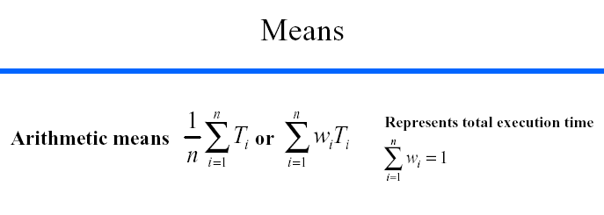


Slide 29
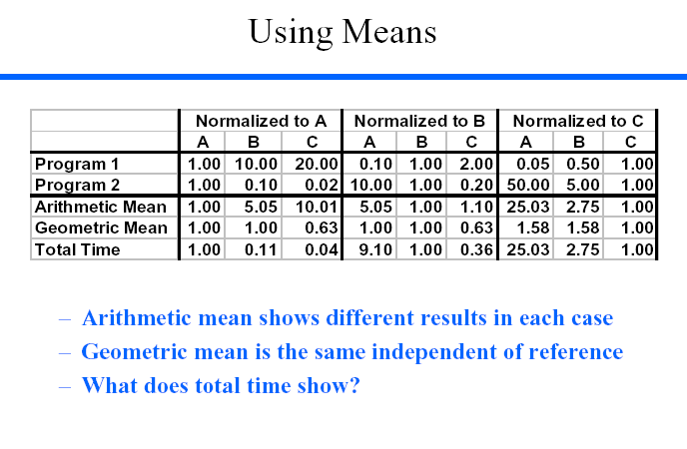

Slide 30
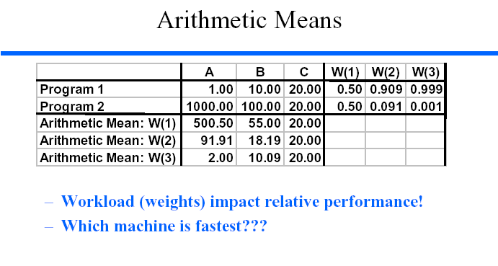

Slide 31
Evaluating Performance of Two Computers
What do you execute?
Ideally
Real applications you use everyday
In reality: Benchmarks
Save money and effort
Smaller than real programs, easier to standardized
Not representative of real workload
To improve the quality of evaluation
Run a set of benchmarks

Slide 32
Benchmark Examples
CPU Benchmark
SPEC89/92/95/2000/2006/2017
Berkeley Multimedia Workload
Transaction Benchmark
TPC-C / TPC-D
3D Benchmark
3DMark 2001
Kernel Benchmark
Linpack or Livermore loops
Microbenchmark
Whetstone and Dhrystone
Try to match real application characteristics

Slide 33
Other Evaluation Tools
Simulator
Speed
Accuracy
Trace
Replay recorded accesses
Cache, branch, register
File/network access
…….
Analysis methods

Slide 34
Be careful what you report (and what others report…)
Killer Application takes X seconds on machine Y
What implementation of the application?
What is the input? What were the options?
What compiler? What optimizations?
What machine configuration? Disk speed? Memory capacity? Etc.
Could you (or someone else) reproduce the results?
You can always reproduce the results of a car magazine’s performance review – why not an architectural experiment???

Slide 35
Improving Performance: Fundamentals
Suppose we have a machine with two instructions
Instruction A executes in 100 cycles
Instruction B executes in 2 cycles
We want better performance….
Which instruction do we improve?

Slide 36
Our Goal: Improve Performance
Minimize time which is a product, NOT isolated terms
Why?
These terms are not necessary independent of each other
Example
ISA change to make an instruction do more work
To decrease the instruction count
But, CPI goes up due to longer instruction execution time

Slide 37
Amdahl's Law
Speedup due to enhancement E:
ExTime w/o E Performance w/ E
Speedup(E) = -------------------- = --------------------------
ExTime w/ E Performance w/o E
Suppose that enhancement E accelerates a fraction P of the
task by a factor S and the remainder of the task is unaffected
then,
ExTime(with E) = ((1-P) + P/S) X ExTime(without E)
Speedup(with E) = 1 (1-P) + p/S
P
P/S

Slide 38
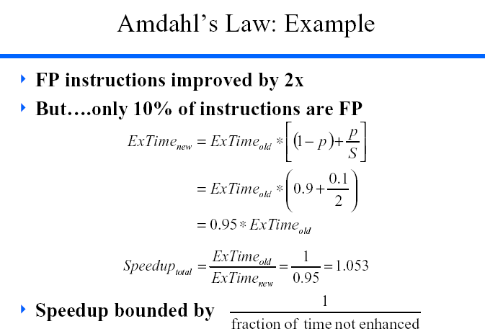

Slide 39
Example－4
A common transformation required in graphics engines is square root. Implementations of floating-point (FP) square root vary significantly in performance, especially among processor designed for graphics. Suppose FP square root (FPSQR) is responsible for 20% of the execution time of a critical graphics benchmark. One proposal is to enhance the FPSQR hardware and speed up this operation by a factor of 10. The other alternative is just to try to make all FP instructions in the graphics processor run faster by a factor of 1.6; FP instructions are responsible for a total of 50% of the execution time for the application. The design team believes that they can make all FP instructions run 1.6 times faster with the same effort as required for the fast square root. Compare these two design alernatives.

Slide 40
Example－4 (cont.)

Slide 41
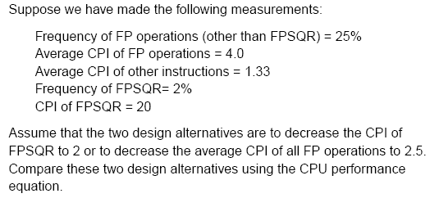
Example－5

Slide 42
Example－5 (cont.)

Slide 43
Improving Performance
Locality
Rule of thumb: a program spends 90% of its execution time in only 10% of the code
Temporal: recently accessed items are likely to be accessed again in the near future
Spatial: items located near each other tend to be accessed close together in time
Concurrency
One of the most important ways to improve performance
Reduces CPI by overlapping execution
Threads, instructions, circuits, etc.

Slide 44
Summary
?

